Slide 4
Added values reflecting of O1 the actualized initiatives of ET 2020
- Helping teachers to turn the traditional teaching into creative and innovative methods (like project-based, inquiry-based, problem-based, work-based, flipped classroom methods);
- Develop teachers’ competences for embracing the potential of Open Educational Resources (OERs) in rapid development of short upskilling trainings;
- Fostering creativity, entrepreneurship in education, enabling continuing professional development of the teaching staff;
- Strengthening the ability of teachers for effective collaboration inside and outside the school;
- Increasing the responsibility of students in their own learning performance and learning process;
- Development of 21st century skills, key competences of students;
- Fostering more effective activities in tracking the working carrier of the graduated students by developing systematic alumni processes.

Slide 7
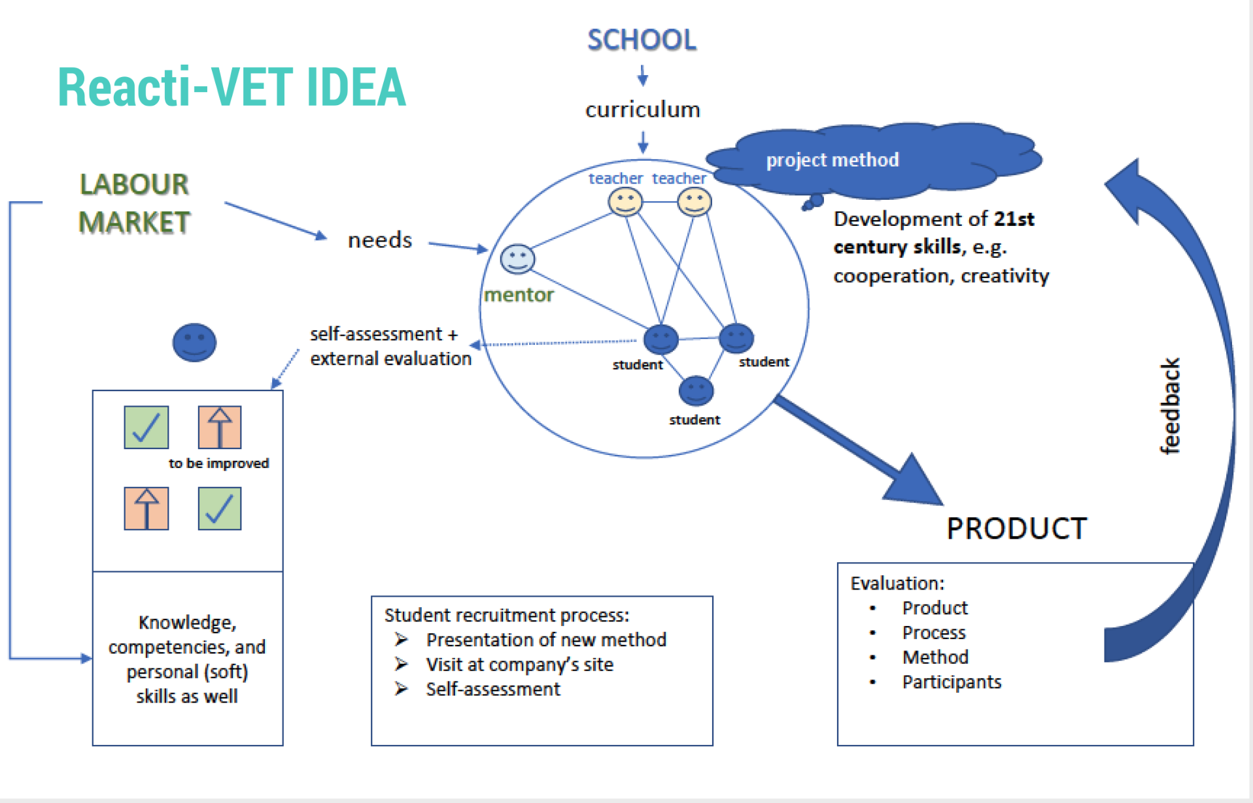

Slide 11
Work Programme:
WHERE???
Documents/project_management/WORKProgramme
Partner tasks:
Documents/project_management/PartnerTasks

Slide 12
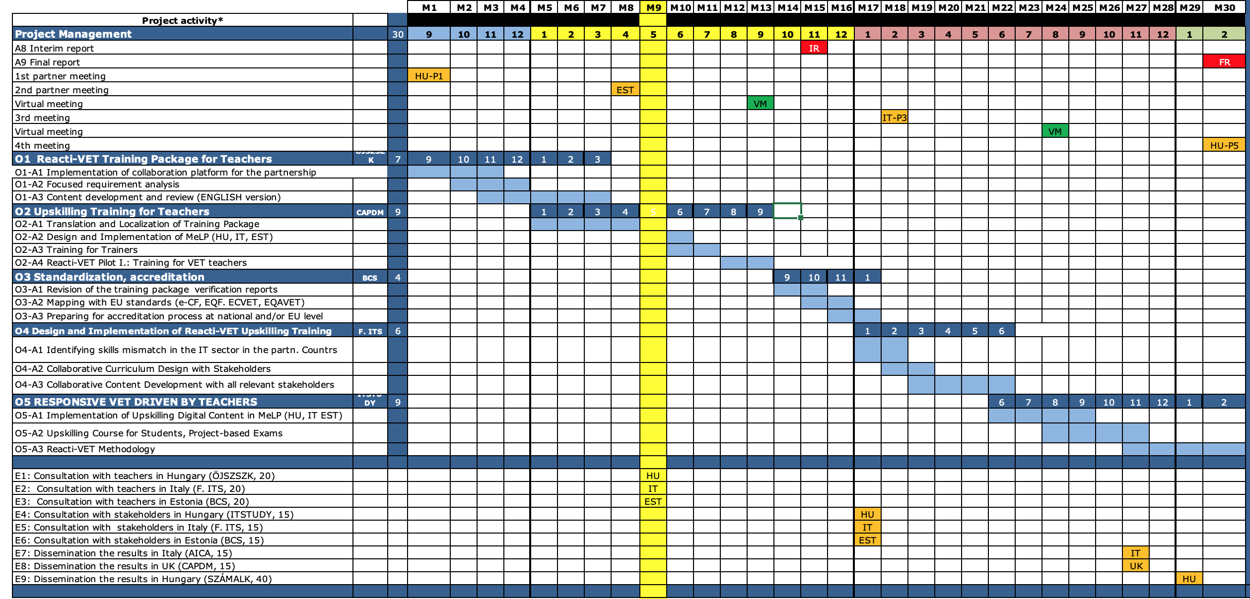

Slide 13
FOCUS: closing O1, speed up O2
Deadline: September 2019

Slide 14
How to CLOSE?
1.
Documentation
Complete final version of the outcomes
Check the indicators, act if needed
3.
Summary
Max 2 pages summary-EN
Newsletters - EN
2.
QM process
Online evaluation questionnaire
Evaluation report-QM manager
4.
Dissemination
Pulblication on the website
FB, Slideshare, etc.
Evaluation-partners
Translation - Partners!

Slide 15
Closing O1
O1 - Reacti-VET Training Package for Teachers Learning / teaching / training material – Toolkit | P6 ÖJSZSZK | 09/2018- 03/2019
O1-A1 Implementation of collaboration platform for the partnership | P1 ITS | 11/2018
INDICATORS: Graphical design components for the portal (logo, wire frame), 4 standard document templates for QM (report, study, agenda). forum, calendar, document repository, evaluation and dissemination forms

Slide 16
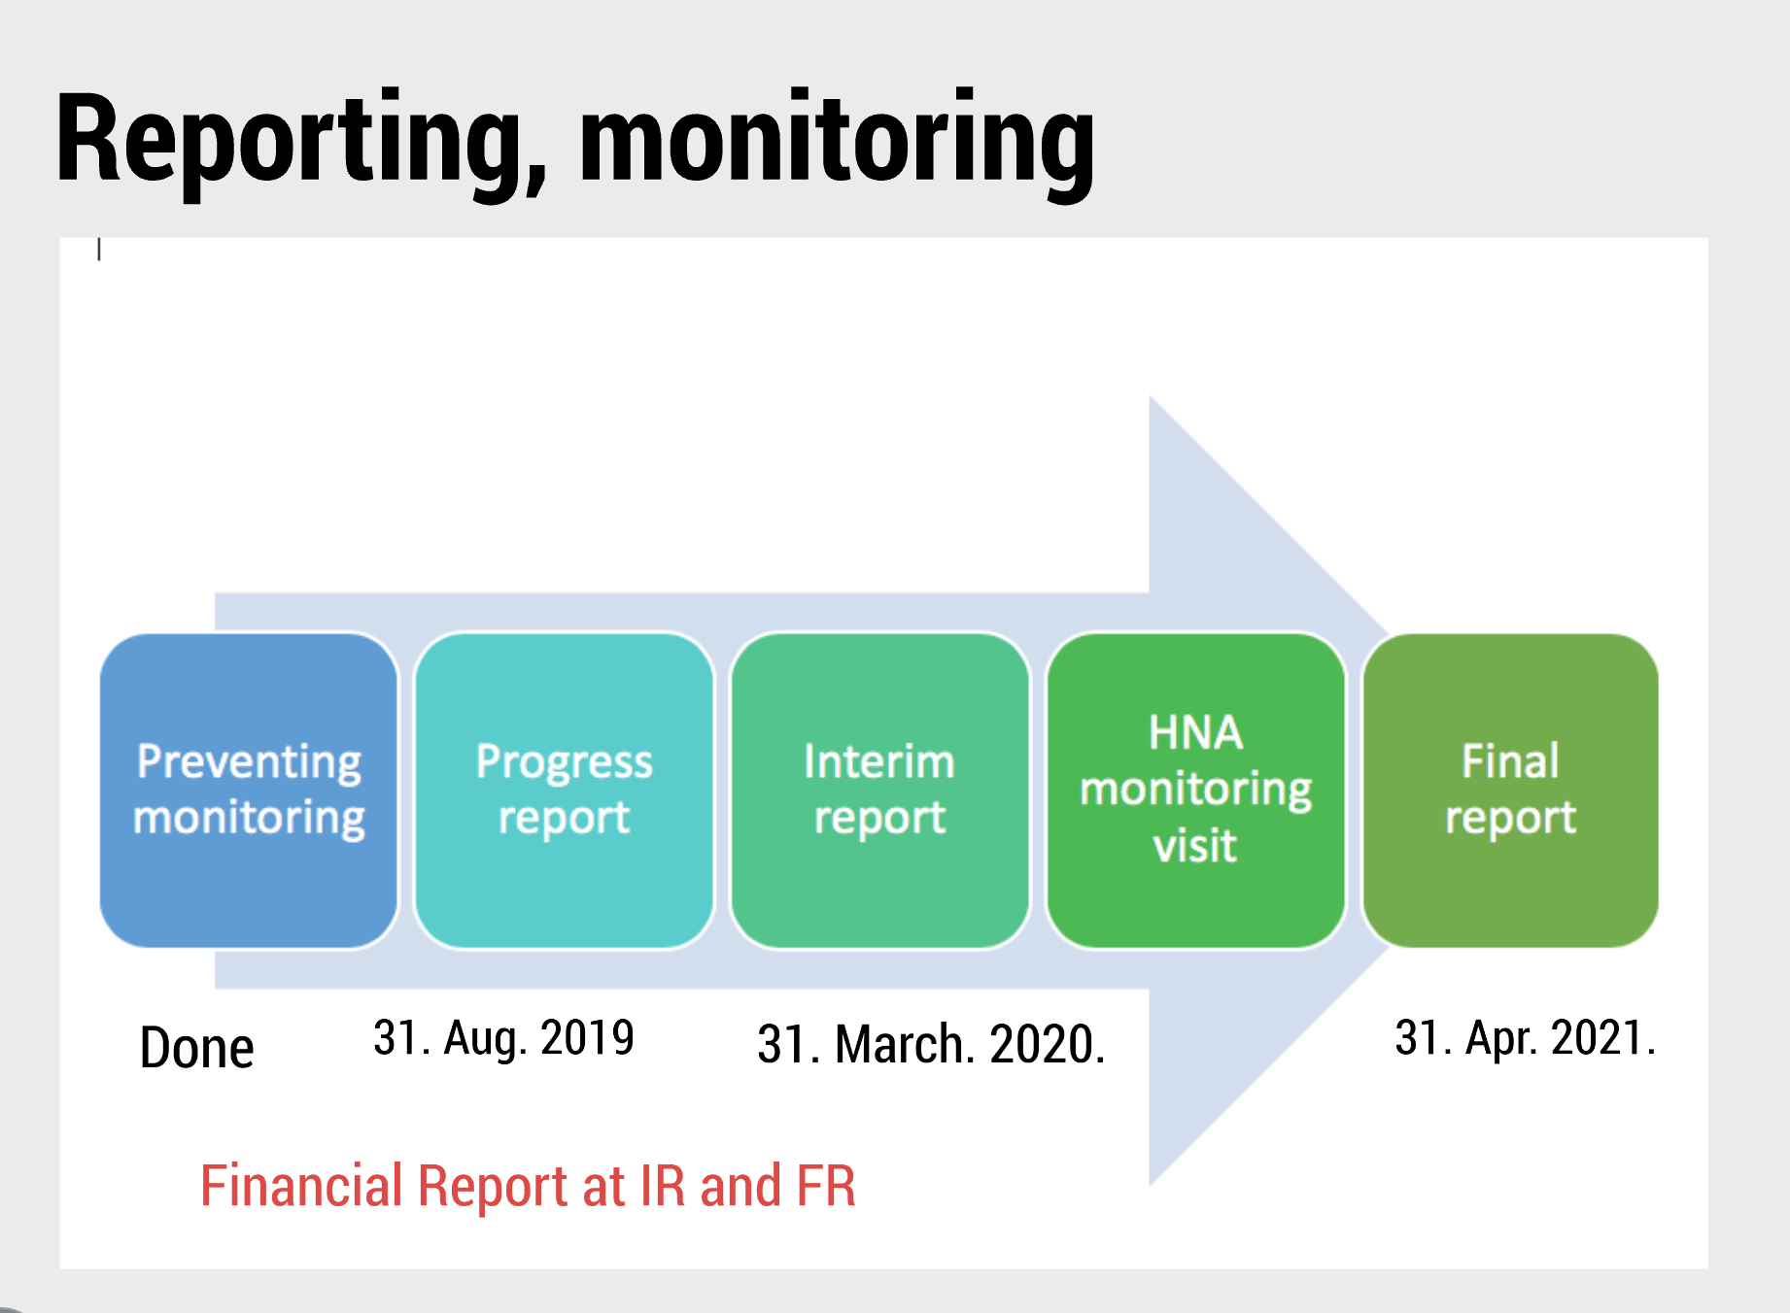

Slide 17
MANAGEMENT

Slide 19
Closing O1-A2
O1-A2 Focused requirement analysis The consortium will design a survey based on an online questionnaire to refine the structure and content of the training package. | All partners | 03/2019
INDICATORS: Number of teachers involved into the requirement analysis: 30/partner countries The results of the national surveys and a summary will be published in English. National reports: 3x20 standard A4 p. with charts, summary with conclusions: 10 p. (25x60=1500 char) Competency Framework, following the guidelines of the European e-Competency Framework for ICT

Slide 20
UPSKILLING MODULES for TEACHERS
1. Innovative teaching methods and classroom management (project-based teaching, flipped classroom method) (P5 SZÁMALK) 2. ICT tools and platforms for online collaboration and project management (P6 OJSZSZK, P4 BCS) 3. Reusing Open Educational Resources in curriculum development (P3 F.ITS P2 AICA) 4. Adapting and implementing an open source learning management framework (P7 CAPDM) 5. ICT tools for data collection and statistical analysis (P1 iTStudy)
INDICATORS: 20 A4 pages/topics (120 p. over six topics), at least 1 video tutorial (maximum 5 minutes long). Further learning objects: 1 assignment as project task/topics, 10 quiz question/topics.

Slide 21
Designing up O2
O2 – Upskilling Training for Teachers Open / online / digital education – E-learning course / module | P6 CAPDM | 01/2019- 09/2019
O2-A1 Translation and Localization of Training Package | P1 ITS | 05/2019
O2-A2 Design and Implementation of MeLP (HU, IT, EST, EN) |  | 06/2019
O2-A3 Training for Trainers Reacti-VET Pilot I.: Training for VET teachers |  | 09/2019
INDICATORS: Number of experts involved into the tutor training: 1-2 persons from each partner. Number of teachers 10-15 participants/target country (Hungary, Estonia, Italy). Workload: 30 -40 hours supposed a teacher with advanced ICT skill, but not experienced in using collaborative web 2.0 tools.
All partners are involved in the curriculum development.

Slide 22
EVENTS related to O2
E1: Consultation with teachers in Hungary (OJSZSZK) E2: Consultation with teachers in Italy (F.ITS) E3: Consultation with teachers in Estonia (BCS) Number of local participants 20/countries | 05/2019
DOCUMENTATION
Inviting letter
Propgram
Attendance list (Name, e-mail, company, school
Photos
Feedback from the participants based on evaluation questionnaire
Concerning the budget: 2 local participant is the same as 1 foreigner

Slide 23
Homework for everybody: Read O3, O4!!!

Slide 24
1st vision of O3
O3 – Learning Content development, translation, review Methodologies / guidelines – Certification system Digital learning content for upskilling course of VET teachers. | P4-BCS | 09/2019- 01/2020
O3-A1 Revision of the training package according to the verification reports |  | 10/2019
O3-A2 Mapping onto EU standards (e-CF, DigComp 2.1, EQF) |  | 11/2019
O3-A3 Preparing for accreditation process at national and/or European level |  | Jan. 2020

Slide 25
Brainstorming on O4
O4-Design and Implementation of Reacti-VET Upskilling Training Course / curriculum – Design and development | P3-F. ITS | 01/2020- 06/2020
O4-A1 Identifying skills mismatch in the IT sector in the partner countries |  | 02/2020
O4-A2 Collaborative Curriculum Design with Stakeholders |  | 03/2020
O4-A3 Collaborative Content Development with all relevant stakeholders |  | 06/2020
INDICATORS: Number of teachers: 3-4-5 teachers. Number of companies: 2/ schools Number of other stakeholders (chamber, policy maker, peers from other school): 1/ school The pilots will run in Estonia, in Hungary. Number of curricula: 4 (1 EST, 3 HU) Learning material planned for 1 semester, minimum 120, maximum 180 hours, newly developed content will be maximum 40% of it, the other 60% must be OER. The contents will be prepared only in national languages
Collaborating: all partners take part in the pilots

Slide 26
Thanks for your attention!
Mária Hartyányi project coordinator
maria.hartyanyi@itstudy.hu

