Slide 1

Module 1.
Innovative learning organising

Slide 2
Aim of the module
Introducing innovative ways to organize learning
Accepting their key role in active learning.
Methods Introduced:
Reverse classroom method
Project method

Slide 3
At the end of the module participants will
have practical knowledge of innovative ways of organizing education,
see the difference between traditional and student-centered learning organization methods,
be aware and consciously apply indirect education strategies during the design process,
also pay attention to the individual characteristics of the learners
use personality development and differentiation as an integral part of their educational process from design to implementation.

Slide 4

Learners’ manual
Short introduction of the module
Assistance in processing and learning the information in the module.

Slide 5

Introduction
Introducing theoretical background
The renewal of the methodological culture
Changes in education
Labor market needs
21st century skills
Changing roles of
teachers and students
Students how we see them

Slide 6
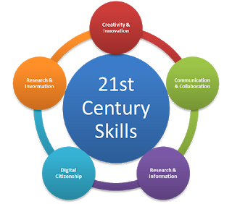
21st century pedagogy
Passive and active learning
Problem and research-based learning
Personalized education to the forefront

Slide 7

Reversed classroom method
Short presentation, main features
Advantages and difficulties of the method
Applying the method in practice

Slide 8
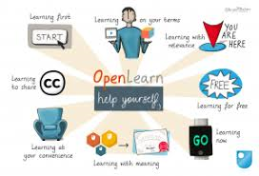
Technical solutions, possibilities in the teaching process
Developing your own curriculum
(video tools)
Online learning repositories
Other useful tools (cooperative tools, task makers, etc.)
Merlot

Slide 9
Assisting in the practical implementation of methods
Tasks
Samples
case history to help you complete the module closing task.

Slide 10
Thank you for your attention!

