Slide 1



Slide 2
General overview

Slide 3
Dissemination results and requirements
1. Produce the dissemination content
2. Disseminate it
3. Make proof of dissemination
4. Enter record in the dissemination webform on the project website: http://reactivet.itstudy.hu/en/forms/dissemination
5. Upload evidences

Slide 4
Dissemination results and requirements
WHAT to disseminate?
Information about the project: background, objectives, partnership, impact etc.
Abstract, brochure
Multimedia content
Information about progress
Project results
Summary of multiplier events

Slide 5
To WHOM to disseminate?
The target audience of the disseminations is:
Headmasters/teachers/trainers/managers working in the VET sectors
VET schools and VET providers
VET students
Employers
Policy makers
Researchers (on scientific conferences)
Other stakeholders - like VET related associations, parents
General public
The project team established an extensive list of stakeholders, which should be used as a reference when organizing events, disseminating project information.

Slide 6
Analysis
19.05.2019

Slide 7
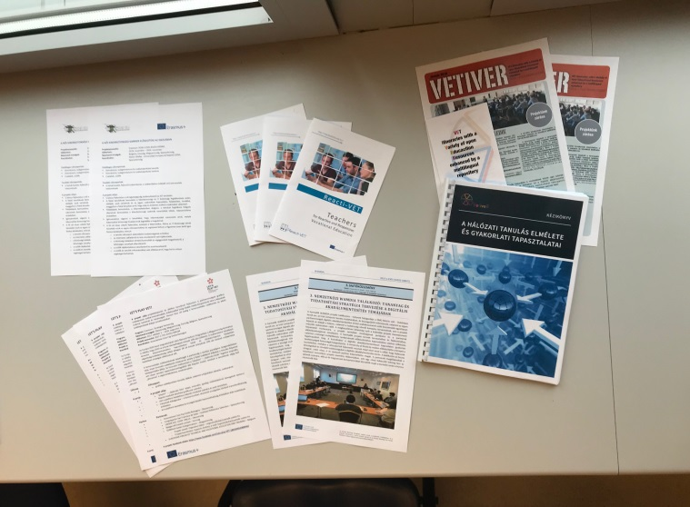
Products of dissemination
Project brochure – including the basic project information
Newsletters – with actual information about the progress of the project
News about the events, partner meetings (2nd meeting.Tallinn)
Project website and partners’ own website
Facebook posts- Dedicated Reacti-Vet Fb profile and partners’ profiles

Slide 8
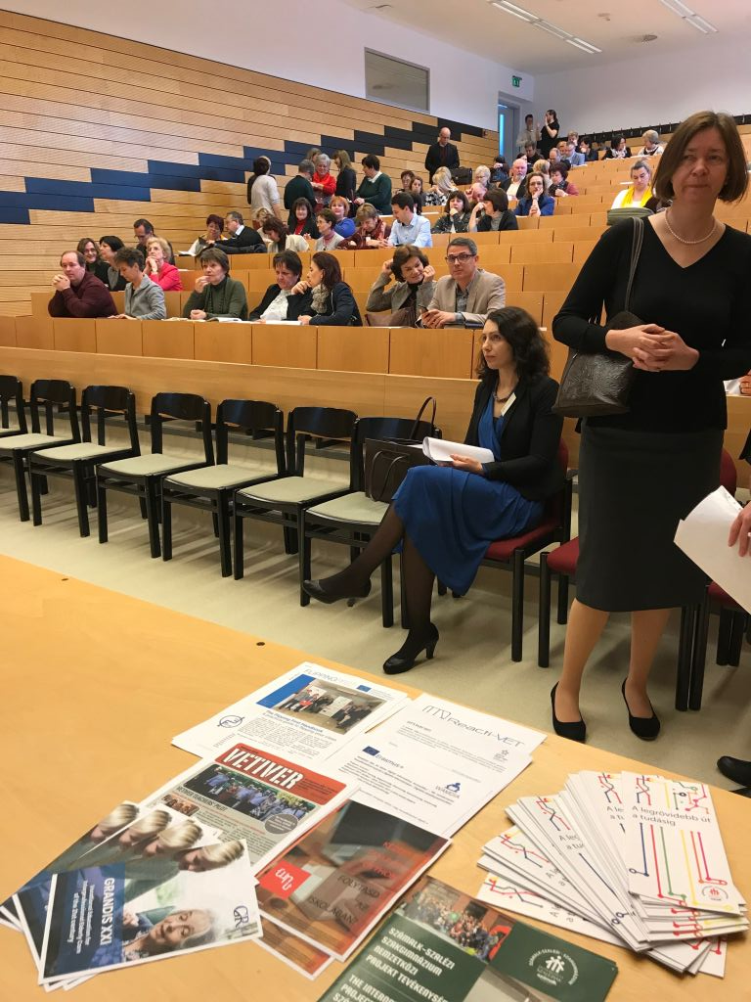

Slide 9
Dissemination
Things to remember
Roll-up banners & posters: upload logos
Newsletter: at the passing of milestones during the project (five issues)
Facebook page: administrative rights to at least one member from each partner for the official Fb page
Embed Reacti-Vet logo in disseminaton

Slide 11


Slide 15
What is next?
Newsletter
Content and timing of publish:
What and when to publish?
Agree on deadlines/schedule
Share the workload
Translation by partners:
English version for the websites as well?

